Slide 1
Malignant comments classifier project presentation
Submitted by Gaurav Borole

Slide 2
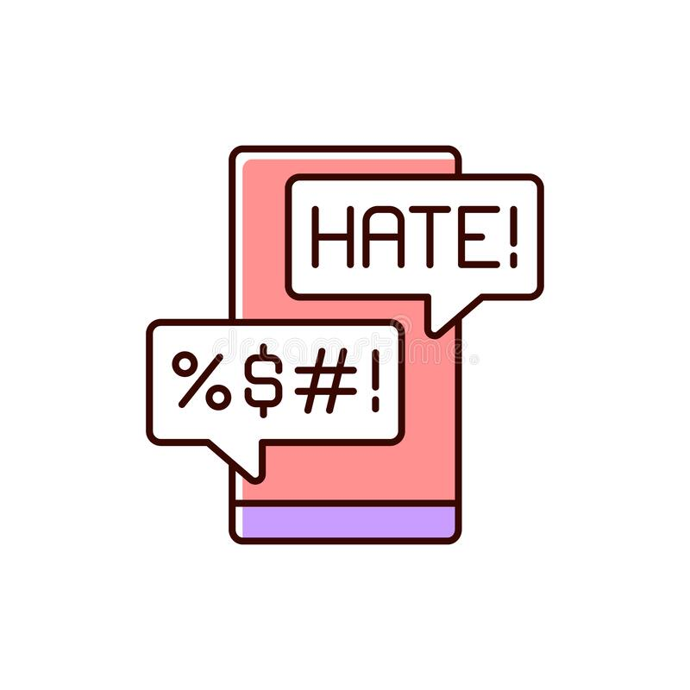
introduction
Over a decade, social media have been growing, and people are able to express their opinions and also discuss among others via these platforms.
These debates may arise due to differences in opinion and may often result in fights over the social media during which offensive language termed as malignant comments may be used from one side.
This clearly pose the threat of abuse and harassment online.
As such, some people stop giving their opinions or give up seeking different opinions which result in unhealthy and biased discussion.
Therefore it results in different platforms and communities finding it very difficult to facilitate fair conversation and are often forced to either limit user comments or get dissolved by shutting down user comments completely.

Slide 3
Problem statement
The proliferation of social media enables people to express their opinions widely online. However, at the same time, this has resulted in the emergence of conflict and hate, making online environments uninviting for users. Although researchers have found that hate is a problem across multiple platforms, there is a lack of models for online hate detection.
Online hate, described as abusive language, aggression, cyberbullying, hatefulness and many others has been identified as a major threat on online social media platforms. Social media platforms are the most prominent grounds for such toxic behavior.
There has been a remarkable increase in the cases of cyberbullying and trolls on various social media platforms. Many celebrities and influences are facing backlashes from people and have to come across hateful and offensive comments. This can take a toll on anyone and affect them mentally leading to depression, mental illness, self-hatred and suicidal thoughts.
Internet comments are bastions of hatred and vitriol. While online anonymity has provided a new outlet for aggression and hate speech, machine learning can be used to fight it. The problem we sought to solve was the tagging of internet comments that are aggressive towards other users. This means that insults to third parties such as celebrities will be tagged as unoffensive, but “u are an idiot” is clearly offensive.
Our goal is to build a prototype of online hate and abuse comment classifier which can used to classify hate and offensive comments so that it can be controlled and restricted from spreading hatred and cyberbullying.

Slide 4
Dataset description
The data set contains the training set, which has approximately 1,59,000 samples and the test set which contains nearly 1,53,000 samples. All the data samples contain 8 fields which includes ‘Id’, ‘Comments’, ‘Malignant’, ‘Highly malignant’, ‘Rude’, ‘Threat’, ‘Abuse’ and ‘Loathe’.
The label can be either 0 or 1, where 0 denotes a NO while 1 denotes a YES. There are various comments which have multiple labels. The first attribute is a unique ID associated with each comment.
The data set includes:
- Malignant: It is the Label column, which includes values 0 and 1, denoting if the comment is malignant or not.
- Highly Malignant: It denotes comments that are highly malignant and hurtful.
- Rude: It denotes comments that are very rude and offensive.
- Threat: It contains indication of the comments that are giving any threat to someone.
- Abuse: It is for comments that are abusive in nature.
- Loathe: It describes the comments which are hateful and loathing in nature.
- ID: It includes unique Ids associated with each comment text given.
- Comment text: This column contains the comments extracted from various social media platforms.

Slide 5
Conceptual Background of the Domain Problem
Online platforms and social media become the place where people share the thoughts freely without any partiality and overcoming all the race people share their thoughts and ideas among the crowd.
Social media is a computer-based technology that facilitates the sharing of ideas, thoughts, and information through the building of virtual networks and communities. By design, social media is Internet-based and gives users quick electronic communication of content. Content includes personal information, documents, videos, and photos. Users engage with social media via a computer, tablet, or smartphone via web-based software or applications.
While social media is ubiquitous in America and Europe, Asian countries like India lead the list of social media usage. More than 3.8 billion people use social media.
In this huge online platform or an online community there are some people or some motivated mob wilfully bully others to make them not to share their thought in rightful way. They bully others in a foul language which among the civilized society is seen as ignominy. And when innocent individuals are being bullied by these mob these individuals are going silent without speaking anything. So, ideally the motive of this disgraceful mob is achieved.
To solve this problem, we are now building a model that identifies all the foul language and foul words, using which the online platforms like social media principally stops these mob using the foul language in an online community or even block them or block them from using this foul language.

Slide 6

Multilabel vs Multiclass classification
As the task was to figure out whether the data belongs to zero, one or more than one categories out of the six listed in our dataset, the first step before working on the problem was to distinguish between multi-label and multi-class classification.
In multi-class classification, we have one basic assumption that our data can belong to only one label out of all the labels we have. For example, a given picture of a fruit may be an apple, orange or guava only and not a combination of these.
In multi-label classification, data can belong to more than one label simultaneously. For example, in our case a comment may be toxic, obscene and insulting at the same time. It may also happen that the comment is non-toxic and hence does not belong to any of the six labels.
Hence, I had a multi-label classification problem to solve. The next step was to gain some useful insights from data which would aid further problem solving.

Slide 7
DATA SCIENCE LIFE CYCLE
Data Cleaning
Import the collected data from web scraping
Exploratory Data Analysis
Check through all the dataset information like datatype, missing value, duplicate value etc.
Visualization and Data Preprocessing
Use various visualization methods to check the data distribution identify presence of outliers and skewness
Clean and format the records as per usage by using various imputation techniques
Analyze each and every data record to ensure we have usable information
Perform encoding and scaling methods

Slide 8
DATA SCIENCE LIFE CYCLE
Model Building
Create appropriate Regression Machine Learning model function
Model Evaluation
Usage of evaluation metrics to check the accuracy of the models over trained and test data inputs
Hyperparameter Tuning Best Model
Choosing the appropriate Regression Machine Learning model to check various parameter permutation and combinations
Need to ensure that whenever the regression function is called it is able to process all the necessary parameters
Ensure the cross validation techniques helps in reducing over fitting and under fitting data
Using Grid Search CV to obtain the best parameters that can be plugged into the selected model

Slide 9

MODEL BUILDING STEPS
1. Data Cleaning
2. Exploratory Data Analysis
3. Data Pre-processing
4. Model Building
5. Model Evaluation
6. Selecting the best model

Slide 10

Data preprocessing
1. Load dataset
2. Remove null values
3. Drop column id
4. Convert comment text to lower case and replace '\n' with single space.
5. Keep only text data ie. a-z' and remove other data from comment text.
6. Remove stop words and punctuations
7. Apply Stemming using SnowballStemmer
8. Convert text to vectors using TfidfVectorizer
9. Load saved or serialized model
10. Predict values for multi class label

Slide 11
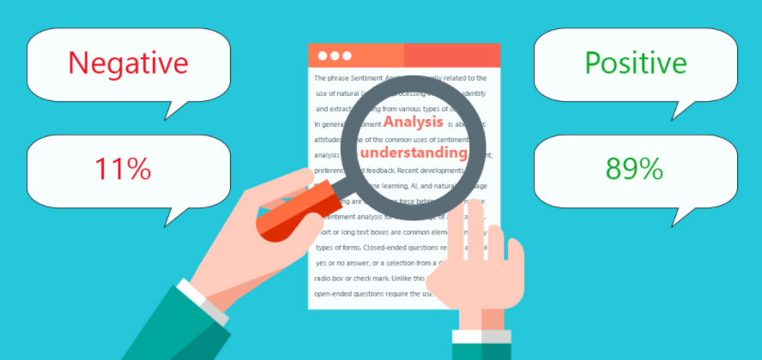
TECHNOLOGY USED
Hardware technology being used.
RAM : 8 GB
CPU : AMD Ryzen 5 3550H with Radeon Vega Mobile Gfx 2.10 GHz
GPU : AMD Radeon ™ Vega 8 Graphics and NVIDIA GeForce GTX 1650 Ti
Software technology being used.
Programming language : Python
Distribution : Anaconda Navigator
Browser based language shell : Jupyter Notebook
Libraries/Packages specifically being used.
Pandas, NumPy, matplotlib, seaborn, scikit-learn, pandas-profiling, missingno, NLTK

Slide 12
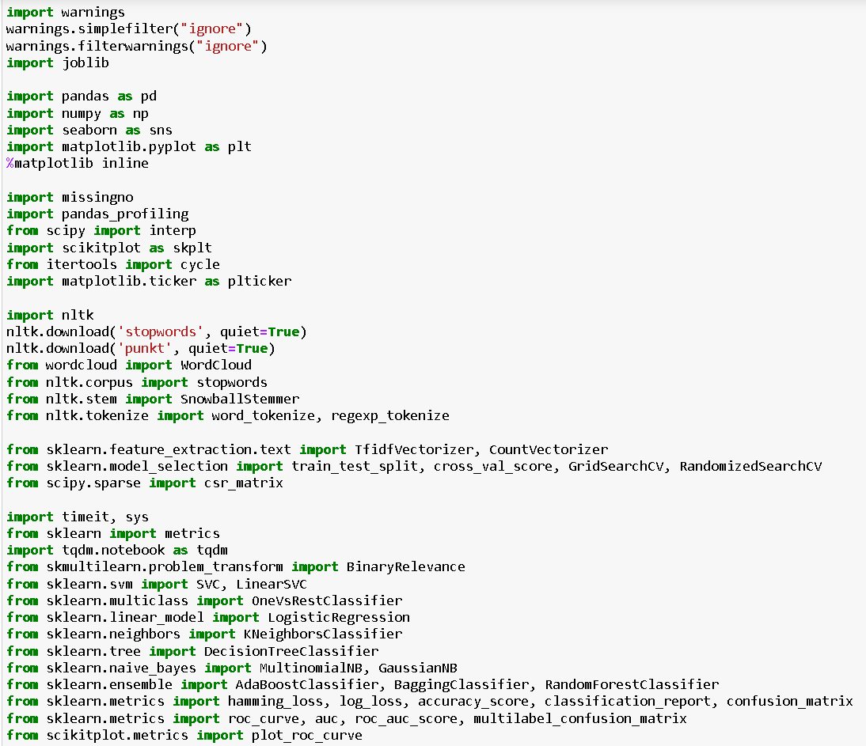
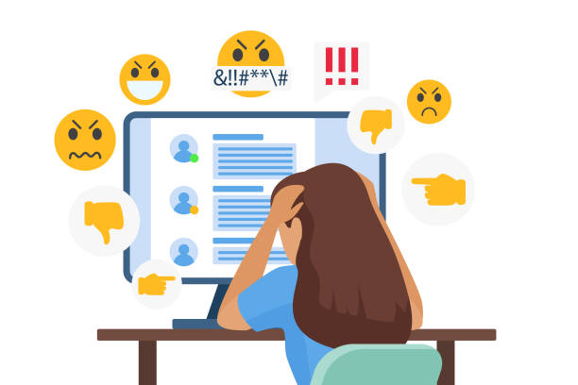
Imported dependencies

Slide 13
EXPLORATORY DATA ANALYSIS (EDA) AND VISUALIZATION
01. Univariate Analysis
02. Multivariate Analysis
03. Correlation of Dataset
Univariate analysis is the simplest form of analyzing data. “Uni” means “one”, so in other words your data has only one variable.
Multivariate analysis is a set of statistical techniques used for analysis of data that contain more than one variable.
Correlation is used to test relationships between quantitative variables or categorical variables.
04. Correlation with Target variable
05. Conclusion
Correlation with the target variable to know how the data is related.
Summary with the conclusion of all the analysis

Slide 14
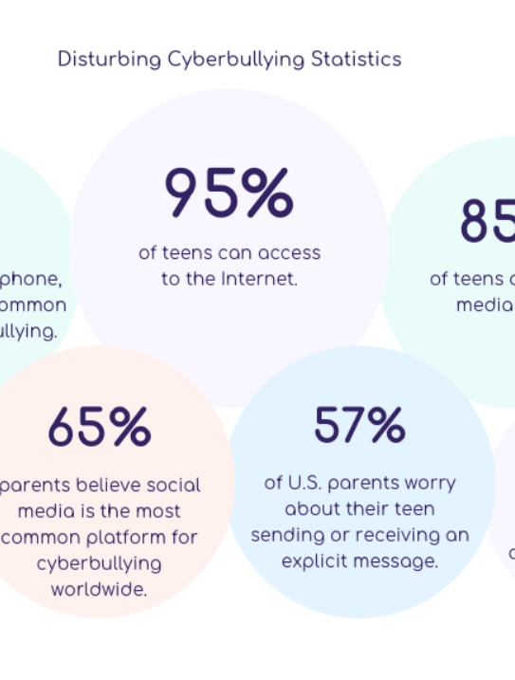
Cyberbullying statistics
Cyberbullying has become a growing problem in countries around the world. Essentially, cyberbullying doesn’t differ much from the type of bullying that many children have unfortunately grown accustomed to in school. The only difference is that it takes place online.

Slide 15
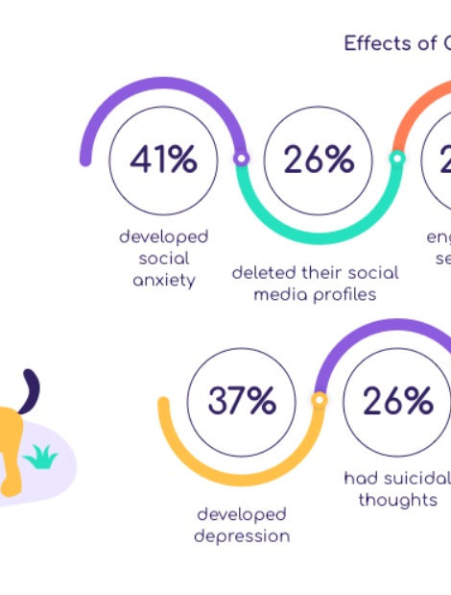
Effects of cyberbullying
Cyberbullying is a very serious issue affecting not just the young victims, but also the victims' families, the bully, and those who witness instances of cyberbullying. However, the effect of cyberbullying can be most detrimental to the victim, of course, as they may experience a number of emotional issues that affect their social and academic performance as well as their overall mental health.

Slide 16
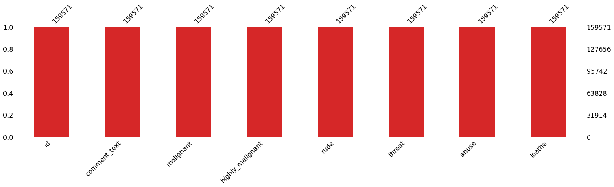
Missing values

Slide 17
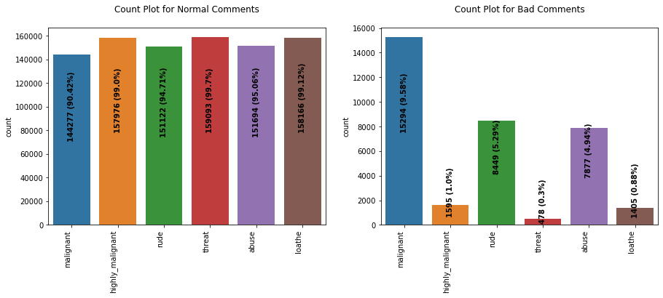
Count plot

Slide 18
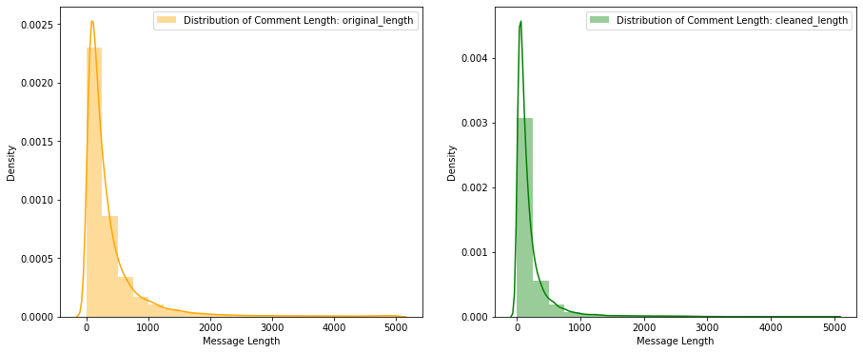
Distribution plot

Slide 19
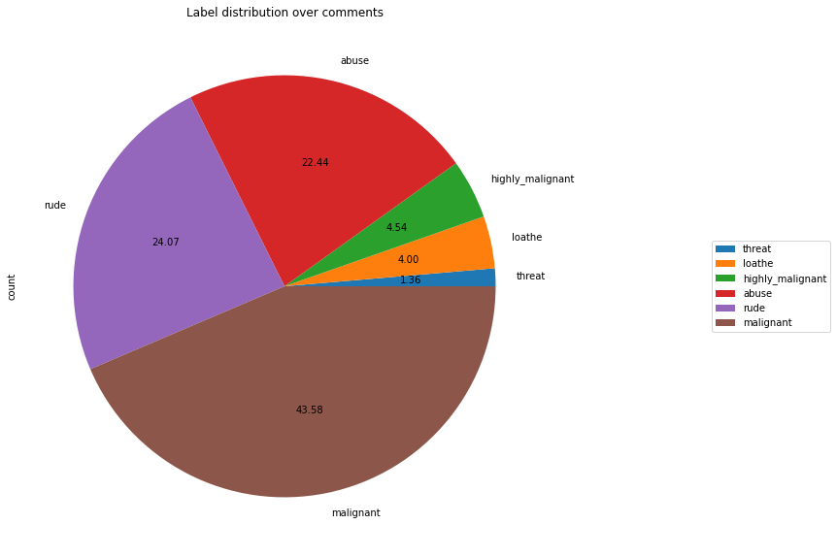
Pie plot

Slide 20
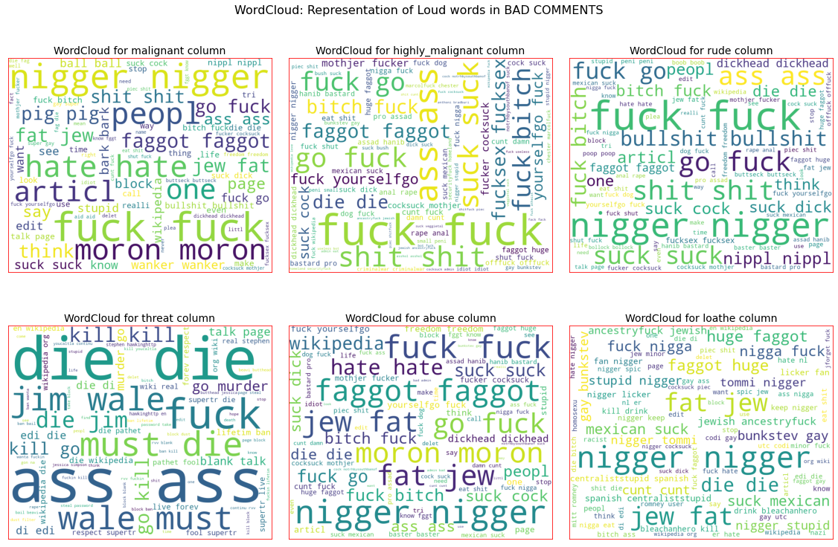
Word cloud

Slide 21
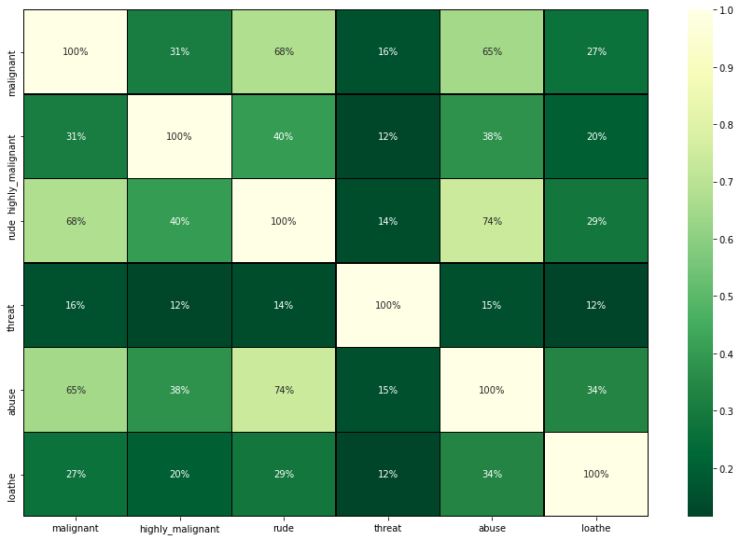
Heatmap

Slide 22
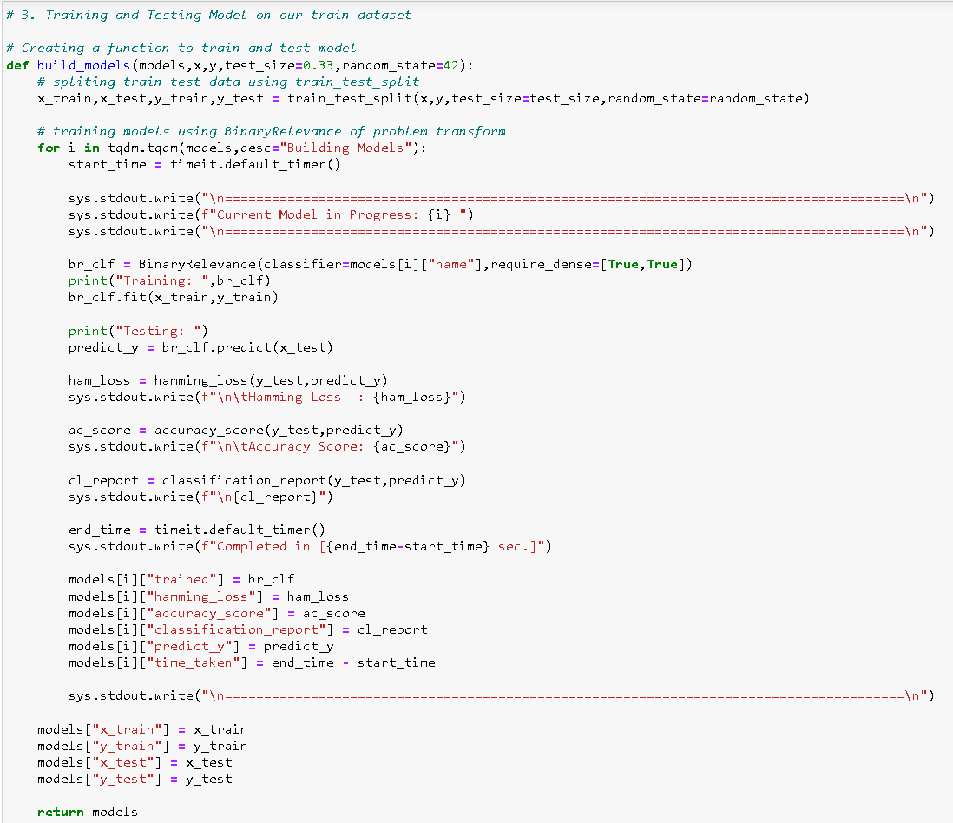
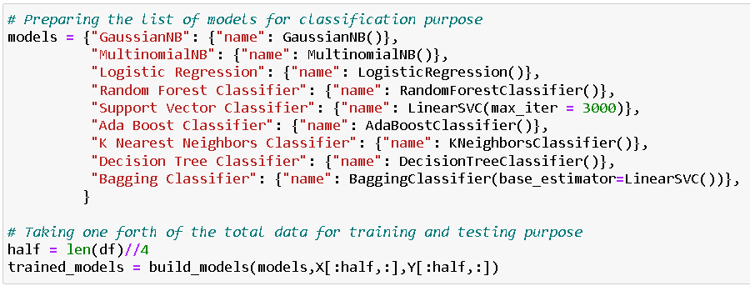
Classification function

Slide 23
Classification machine learning models

Slide 24
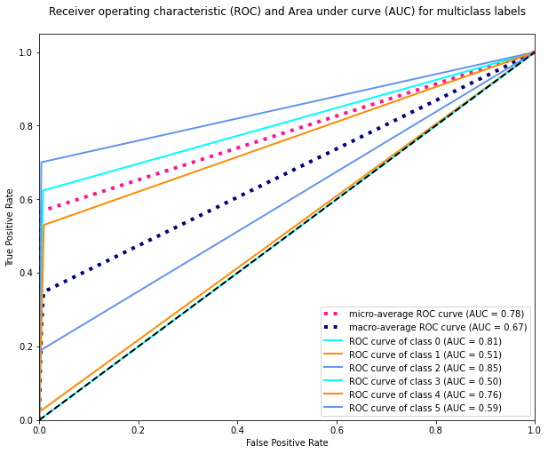
ROC AUC CURVE

Slide 25
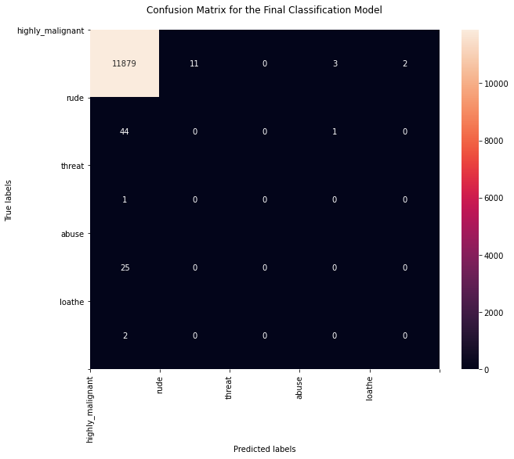
Confusion matrix

Slide 26
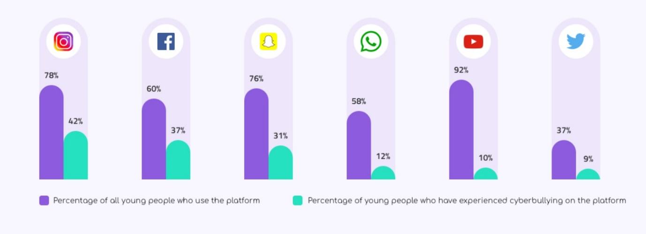
Key Findings and Conclusions of the Study
The finding of the study is that only few users over online use unparliamentary language.
And most of these sentences have more stop words and are being quite long.
As discussed before few motivated disrespectful crowds use these foul languages in the online forum to bully the people around and to stop them from doing these things that they are not supposed to do.
Our study helps the online forums and social media to induce a ban to profanity or usage of profanity over these forums.

Slide 27
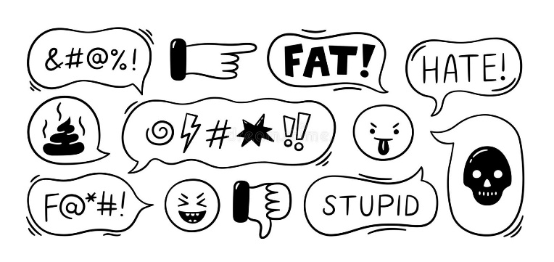
Learning Outcomes of the Study in respect of Data Science
Through this project we were able to learn various Natural language processing techniques like lemmatization, stemming, removal of stop words. We were also able to learn to convert strings into vectors through hash vectorizer. In this project we applied different evaluation metrics like log loss, hamming loss besides accuracy.

Slide 28
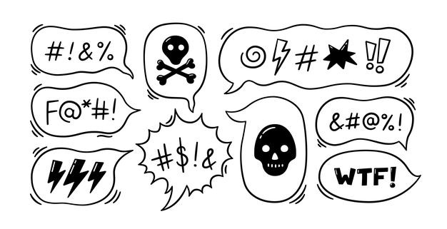
Learning Outcomes of the Study in respect of Data Science
My point of view from my project is that we need to use proper words which are respectful and also avoid using abusive, vulgar and worst words in social media. It can cause many problems which could affect our lives. Try to be polite, calm and composed while handling stress and negativity and one of the best solutions is to avoid it and overcoming in a positive manner.

Slide 29
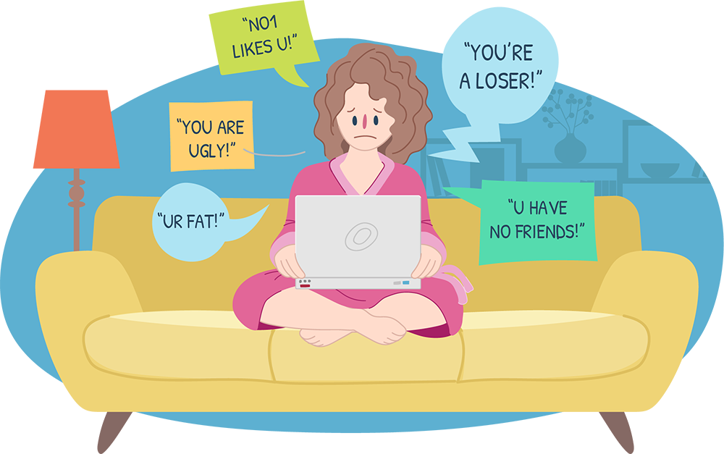
Limitations of this work and Scope for Future Work
Problems faced while working in this project:
More computational power was required as it took more than 2 hours
Imbalanced dataset and bad comment texts
Good parameters could not be obtained using hyperparameter tuning as time was consumed more
Areas of improvement:
Could be provided with a good dataset which does not take more time.
Less time complexity
Providing a proper balanced dataset with less errors.

Slide 30

THANK YOU

